Slide 1
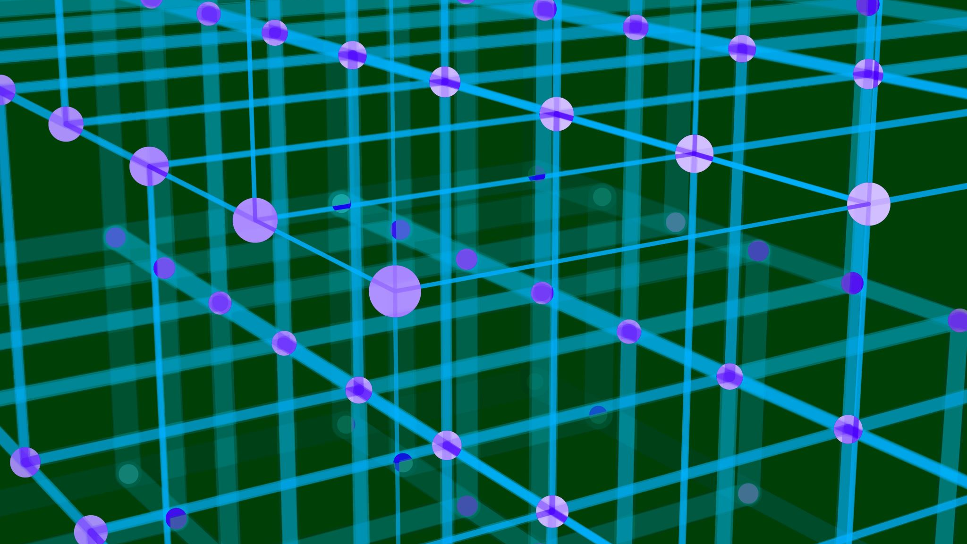
MultiAgent Systems & Coordination

Slide 2
Recap / Problem Statement
Many current AI systems are built as single agents: one model or “brain” that handles everything (reasoning, tool use, orchestration).
But as tasks get more complex (multi-step workflows, branching, retry logic, coordination, concurrency), the limitations become clear.
We need modular, distributed, coordinated agent systems.

Slide 3
Why a Single Agent (Even with Many “Roles”) Fails / Struggles
Challenge | Explanation / Example
Cognitive overload | One agent must keep track of many sub-tasks, context switching, failure handling, branching logic the prompt/design becomes huge and brittle.
Poor modularity & maintainability | If you try to bake in many roles (researcher, summarizer, planner, QA) into one agent, changes or bugfixes in one subdomain risk breaking the rest.
Single point of failure / bottleneck | The single agent becomes a performance, latency, or availability bottleneck. If it fails or misroutes something, the whole workflow dies.
Limited concurrency / parallelism | Multi-step workflows sometimes benefit from parallelism (e.g. multiple subtasks done concurrently). A monolithic agent handles steps serially.
Lack of specialization | Different subtasks benefit from specialization (one agent fine-tuned for math, another for summarization, another for planning). One agent must be a jack-of-all.
Complex error recovery / coordination | Handling retries, fallback logic, interdependencies is harder in a flat monolithic architecture.

Slide 4
Scenario: Market Research and Report Writing Agent
You design a single LLM-based agent called “BizBot” that plays multiple roles:
Researcher (finds latest data and statistics)
Analyst (summarizes and interprets data)
Writer (drafts the final business report)
The idea is that one agent prompt handles all three.

Slide 5
What Actually Happens
Task 1: Data Research
The agent searches and extracts market size data for 2024.
However, it misunderstands part of the instruction and includes 2022 data as well.
It stores the results in its local context (memory buffer).
Task 2: Data Analysis
The same agent switches to “Analyst” mode.
It starts analyzing before verifying or cleaning the dataset.
Because the roles share a single memory state, there is no validation checkpoint between research and analysis.
Task 3: Report Writing
The “Writer” role begins drafting the final report.
It assumes the earlier analysis was correct, citing 2022 trends as current market data.
The final output looks coherent but is factually wrong.

Slide 6
Failure Point (Why Single-Agent Multi-Role Fails)
Issue | Description
Role Interference | Context from one role bleeds into another (no clean handoff or validation).
No Synchronization | The “Analyst” started before verifying that the “Researcher”’s data was valid.
No Cross-Check Mechanism | The “Writer” trusted the analysis blindly because there’s no second agent to challenge or review it.
Single-State Bottleneck | All stages depend on a single evolving context window, making debugging and traceability hard.
Notes:
Context fatigue

Slide 7
What a Multi-Agent System Would Do Instead
Agent A (Researcher) → gathers data →
Agent B (Analyst) → verifies + summarizes results →
Agent C (Writer) → drafts report →
Supervisor Agent → validates dependencies and ensures correct order.
Each agent passes outputs through structured messages or shared state graphs (like in LangGraph), ensuring dependencies are respected and verified before proceeding.

Slide 8
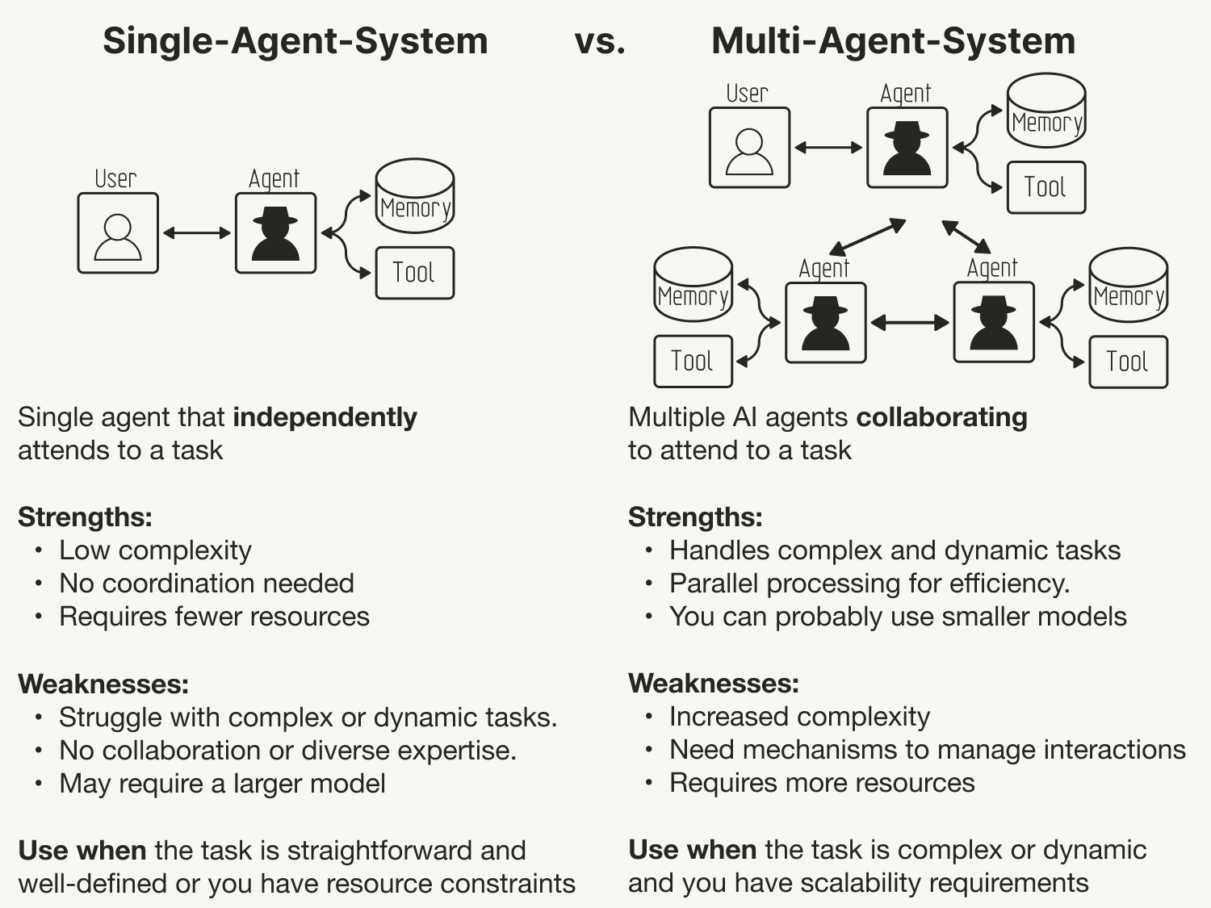

Slide 9
What Multi-Agent Systems Bring to the Table
Decomposition & specialization: break a complex task into sub-agents with focused roles (planner, worker, evaluator, etc.).
Coordination & orchestration: agents communicate, hand off work, synchronize.
Scalability & parallelism: some agents can run in parallel or be replicated.
Robustness & fault tolerance: if one agent fails or underperforms, alternatives or fallback agents can intervene.
Dynamic adaptability: you can add or remove agents, redirect workflows, branch logic based on intermediate states.
Clear responsibility boundaries: each agent has a narrower interface, easier to test, monitor, and correct.

Slide 10
Theoretical Foundation: Core Principles of Multi-Agent Systems
Property | Meaning | Example in AI Agents
Autonomy | Operate without direct human or external control. | Researcher agent plans and executes tasks independently.
Social Ability | Communicate and cooperate with other agents via messages. | Critic agent gives structured feedback to Planner agent.
Reactivity | Respond to environment or state changes in real time. | Sensor agent reacts to weather updates in drone scenario.
Proactivity | Initiate actions to achieve goals rather than waiting for triggers. | Planner generates new subtasks when gaps are detected.

Slide 11
Autonomous Agent Collaboration Types
Multi-agent systems can collaborate in different ways depending on their objectives
Collaboration Type | Description | Example Scenario
Cooperative | Agents share a common global goal. | CrewAI team working together to generate a project proposal.
Competitive | Agents have conflicting objectives. | Trading bots bidding for limited assets.
Mixed-Motive | Partially aligned interests; negotiation required. | Debate-style or peer-review agents arguing toward consensus.

Slide 12
Messaging Protocols & Communication Standards
Component | Simple Meaning | Example
Sender | Kaun bhej raha hai | Planner
Receiver | Kisko bhej raha hai | Researcher
Message Type | Kis type ka message hai | “REQUEST” (kaam kar do), “INFORM” (yeh result hai), “CONFIRM” (kaam done), “REJECT” (nahi ho saka), “PROPOSE” (yeh suggestion hai)
Content | Actual message ka data | “Find 3 latest papers on AI”
Timestamp / ID | Message ka unique number ya time | ID = 102, Time = 12:30 PM
Communication defines how autonomous agents collaborate effectively.
Key elements of a messaging protocol:
  Message Components:
    Sender
    Receiver
    Message Type (request, inform, confirm, reject, propose)
    Content
    Timestamp or ID

Slide 13
Protocol Type | Meaning | Explanation | Simple Real Example
1. FIPA-ACL (Formal Standard) | Foundation for Intelligent Physical Agents – Agent Communication Language | Ye ek official standard hai jo batata hai ki agents message kaise likhen. Har message mein ek type hota hai jaise — REQUEST, INFORM, CONFIRM, REJECT, PROPOSE. | Planner agent sends → REQUEST: "Find latest AI papers" Researcher replies → INFORM: "3 papers found“ Planner replies → CONFIRM: "Received"
2. Asynchronous Messaging | Non-blocking messaging | Ek agent message bhej deta hai aur aage kaam karta rehta hai. Reply baad mein aata hai. Yeh system fast aur scalable hota hai. | Planner → “Research karo” Researcher baad mein reply karega jab ready ho. (Jaise email bhejna — foran reply nahi milta)
3. Synchronous Messaging | Real-time blocking message | Ek agent doosre ka wait karta hai jab tak reply na aaye. Yeh ordered communication hoti hai. | Planner calls Researcher → “Find data abhi.” Researcher → “Okay, done.” (Jaise phone call — dono ek saath baat karte hain)

Slide 14
Common Protocols:
  FIPA-ACL → Grammar and rules for agent conversation.
  Asynchronous → Agent’s WhatsApp (non-blocking).
  Synchronous → Agent’s phone call (instant back-and-forth).
Best Practices:
  Define clear message schemas (avoid ambiguity).
  Use acknowledgments or retries for reliability.
  Keep memory of conversation history to avoid circular messaging.

Slide 15
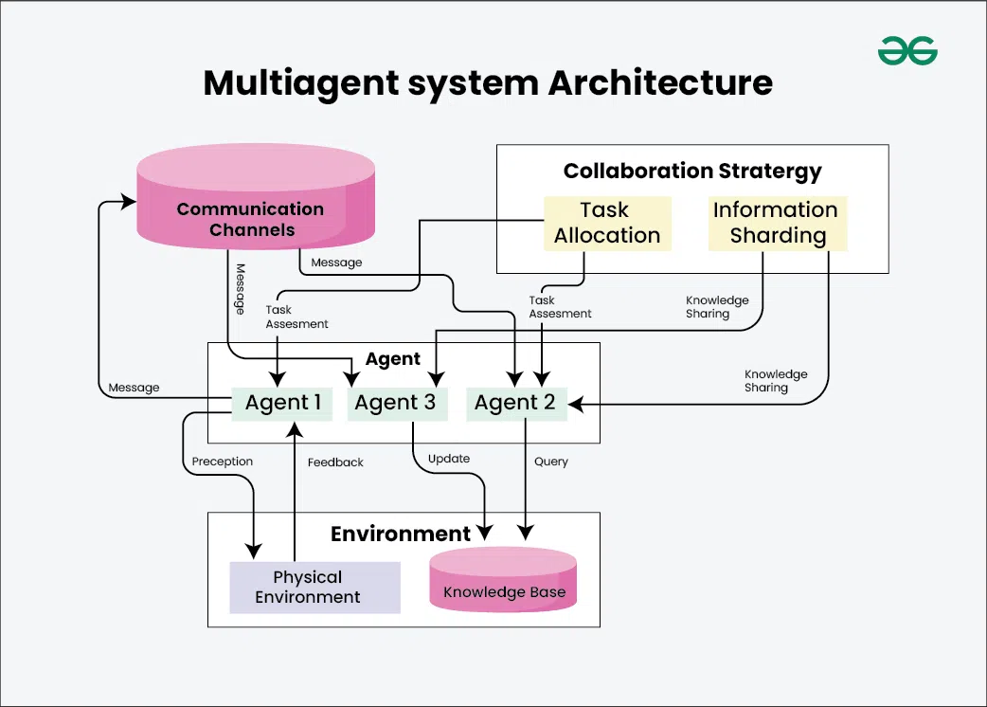
LangGraph state object / shared memory / event bus
Supervisor agent in LangGraph / Crew Manager in CrewAI
Autonomy
Coordination
Communication
Adaptivity
APIs, databases, sensors, vector store, or user interface

Slide 16
Coordination Strategies in Multi-Agent Systems
Strategy | Description | Example Use | Strengths | Weaknesses
Centralized | One controller assigns tasks to subagents. | CrewAI “Manager Agent” | Simple control | Single point of failure
Hierarchical | Supervisor → subteam → workers. | LangGraph multi-layer orchestration | Clear structure | Slower adaptation
Decentralized (Swarm) | Agents coordinate via shared signals, no leader. | Traffic simulation, sensor networks | High scalability | Hard to debug
Market-based (Contract Net) | Tasks are auctioned; best bidder executes. | Resource allocation systems | Efficient | Requires negotiation logic
Blackboard Model | Shared workspace; agents post/read intermediate results. | Problem-solving MAS | Collaborative | Needs strong synchronization

Slide 17
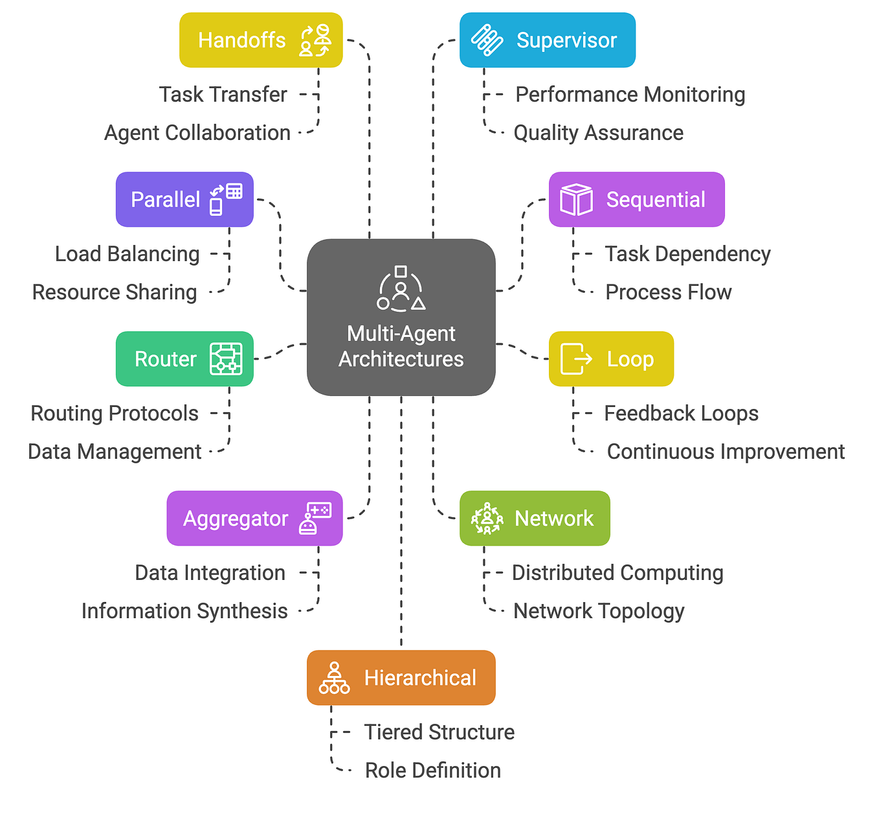
Coordination + Communication + Collaboration

Slide 18
Pattern | Simple Meaning | Agentic AI Example
Handoffs | Ek agent ka task doosre ko transfer hota hai sequential collaboration. | Planner agent assigns task → Researcher agent executes it.
Parallel | Multiple agents ek saath kaam karte hain (load balancing). | Multiple summarizers run on different documents at once.
Router | Ek agent route karta hai kaunsa task kis agent ko bhejna hai. | Supervisor in LangGraph routes queries to right sub-agent.
Aggregator | Alag-alag agents ke outputs combine karke ek final result banta hai. | Reviewer agent merges multiple research summaries.
Hierarchical | Top-level agents (supervisors) control niche-level agents. | Crew Manager → Team Leads → Workers (CrewAI).
Network | Peer-to-peer system har agent apas me directly baat karta hai. | AutoGen’s conversational agents.
Loop | Feedback-based structure agents continuously improve result. | Critic agent giving iterative feedback to Writer agent.
Sequential | Ek ke baad ek agents kaam karte hain in fixed order. | LangChain-style sequential pipelines.
Supervisor | Ek master agent performance monitor karta hai aur quality ensure karta hai. | LangGraph’s “Supervisor Node” watching worker agents.

Slide 19
Core Building Blocks / Subtopics
Autonomous Agent Collaboration
- How agents decide who does what
- Negotiation, delegation, subtask routing
- Handling conflicts, dependencies, resource contention
Messaging / Communication Protocols
- Synchronous vs asynchronous messaging
- Channels, queues, publish/subscribe
- Message formats, contracts, schemas
- Acknowledgments, retries, error signaling
Coordination Strategies
- Centralized orchestration (supervisor / controller)
- Peer-to-peer (swarm) coordination
- Hierarchical coordination (teams, supervisors)
- Contract net, blackboard, token rings, consensus, auctions
Frameworks & Tooling
- CrewAI
- AutoGen
- LangGraph

Slide 20
Overview of CrewAI & AutoGen
CrewAI
- Role-based abstraction: define a “crew” of agents, each with a role & responsibilities.
- Good for structured teams / business workflows.
- Lean, simpler orchestration, faster prototyping.
- But limited flexibility in branching logic or dynamic graph flows.
- Some empirical studies show coordination failures in edge cases (e.g. in robotic or multi-agent setups)
AutoGen
- Built for collaborative, conversational multi-agent settings.
- Agents talk to each other, passing messages, reasoning, negotiating.
- Good for back-and-forth discourse, brainstorming, negotiation tasks.
- But lacks higher-order workflow control abstractions; developer must design the orchestration logic manually.
- Works well for prototyping, but scaling or more rigid workflows can be brittle

Slide 21
Why LangChain (alone) Isn’t Enough for Multi-Agent
LangChain is primarily designed around chains / sequential pipelines and agent + tool wrappers.
It lacks built-in support for graph-based workflows, dynamic routing, branching, or inter-agent messaging.
Memory & state management across multiple agent instances is ad hoc and can become inconsistent or tangled.
As we scale, orchestration logic gets pushed into our own code (ad hoc controllers, branching logic), which leads to boilerplate and fragility.
Developers often “reinvent” orchestration on top of LangChain when trying to build multi-agent systems.
The abstraction is too coarse: chaining, callbacks, tool calls—but not full multi-agent graph workflow support.
Hence, the need for a lower-level orchestration / graph layer on top of or alongside LangChain.

Slide 22
LangGraph & Why It Helps
LangGraph is a graph-based orchestration framework designed to enable multi-agent workflows.
Key ideas:
• Represent agents / tasks as nodes in a directed graph, with edges defining routing / dependencies.
• A shared state object flows through nodes; nodes may read, modify, branch based on state.
• Dynamic routing / conditional edges based on intermediate results.
• Built-in memory, checkpointing, orchestration primitives, “supervisor” & “swarm” architectures.
• Debugging, tracing, observability (via LangSmith) and modularity.
Because LangGraph is lower-level, you get flexibility: you can build hierarchical agents, mixtures of orchestration styles, or integrate workflows with other parts of LangChain.
You avoid reinventing routing logic, context passing, error handling, branching semantics—all are supported by the graph abstraction.

Slide 23
Multi-Agent Architectures in LangGraph
Supervisor architecture: one master agent routes tasks to sub-agents, collects results, decides final output.
Swarm / peer architecture: agents collaborate more peer-to-peer, negotiate, or pass messages directly.
LangGraph supports both, and you can mix them.
Example: The “City Information System” on AWS (LangGraph + Mistral) uses LangGraph to route tasks (weather, events, transport) through agents.
We can also visualize the graph, checkpoints, fallback routes, loops, branching.

Slide 24
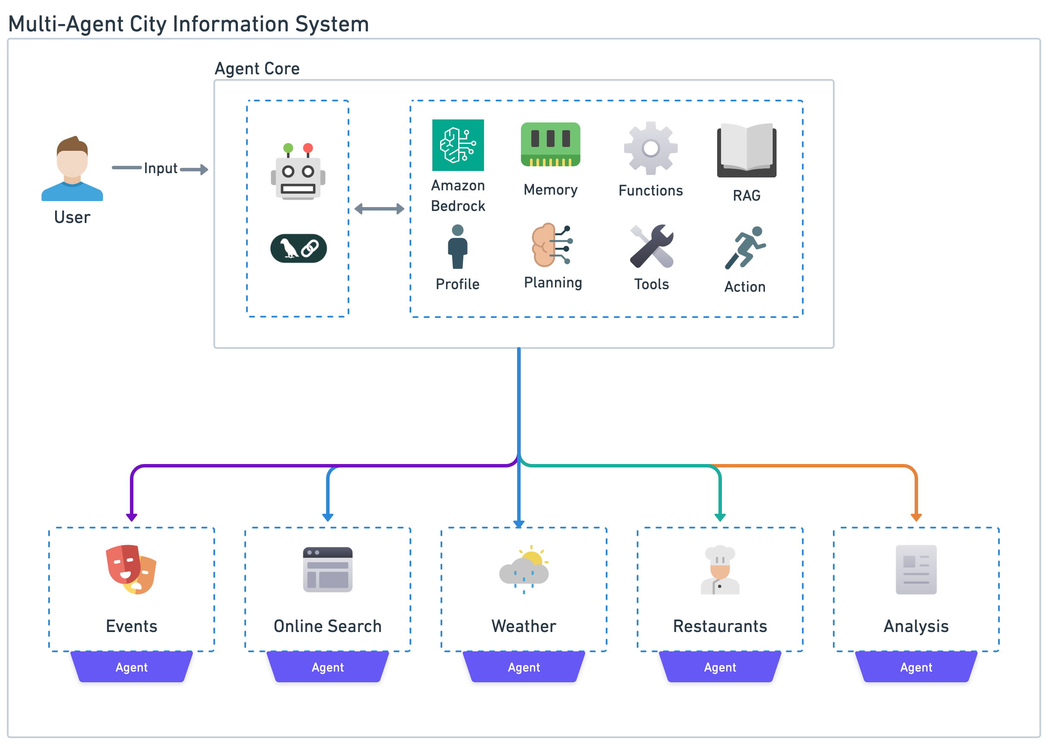

Slide 25
Comparison Table: CrewAI vs AutoGen vs LangGraph
Feature / Capability | CrewAI | AutoGen | LangGraph
Role / crew abstraction | yes | limited | yes (via graph node agents)
Graph / branching workflows | limited | minimal (you build manually) | native graph support
Routing / conditional logic | basic | manual | built-in
Scalability / concurrency | moderate | moderate | strong (parallel nodes)
Debugging / observability | limited | manual | good (tracing, checkpoints)
Flexibility & customization | moderate | high | very high (low-level primitives)

Slide 26
Many analyses show that while CrewAI and AutoGen are great for simpler cases, they become brittle in complex workflows, whereas LangGraph gives you the building blocks to scale.
Caveats: LangGraph’s lower-level nature means more responsibility on the developer; you must define your state, routing, node logic, etc. Some logging / complexity overhead.

Slide 27
When to Use Multi-Agent / LangGraph
Workflows with branching or conditional logic (not strictly linear)
Tasks that decompose into parallelizable subtasks
Cases needing error retry, fallback, recovery logic
Systems needing scalability, modularity, extendibility
Complex orchestration or dynamic workflows where you don’t want to hardcode control logic
When you expect to iterate / evolve the workflow rather than fix it once

Slide 28
When NOT to Use Multi-Agent Systems
Limitation | Why It Happens | Consequence
Communication overhead | Each message = API call or delay. | Higher cost & latency.
Complex debugging | Parallel reasoning → hard to trace failures. | Unpredictable outputs.
State synchronization | Multiple agents modify same data. | Inconsistent memory states.
Emergent misalignment | Independent goals can conflict. | Unstable behavior.
Overengineering risk | Simple tasks don’t need full MAS. | Wasted complexity.

Slide 29
Challenges & Considerations
Overhead: inter-agent communication, latency, coordination costs
Designing clear message schemas, contracts, state consistency
Handling failures, retries, race conditions
Debugging distributed logic is harder
Designing consistent memory / state sharing
Ensuring agents don’t “fight” or conflict
Tradeoff between expressiveness and complexity (too fine-grained agents can be overkill)

